Slide 1
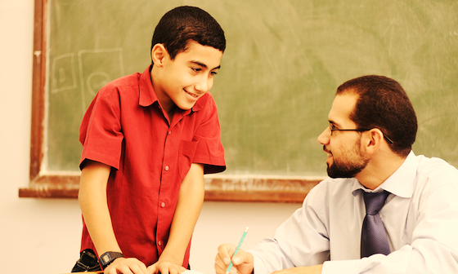
Building Relationships
and Making a Good Impression

Slide 2
Why should you build a relationship with your teachers?
Teachers are more likely to help students they know and trust.
Strong relationships make school feel safer and more fun.
You’ll do better in school when you feel supported.

Slide 3
Actions That Build Relationships

Slide 4


Slide 5

Say goodbye to every teacher everyday.

Slide 6
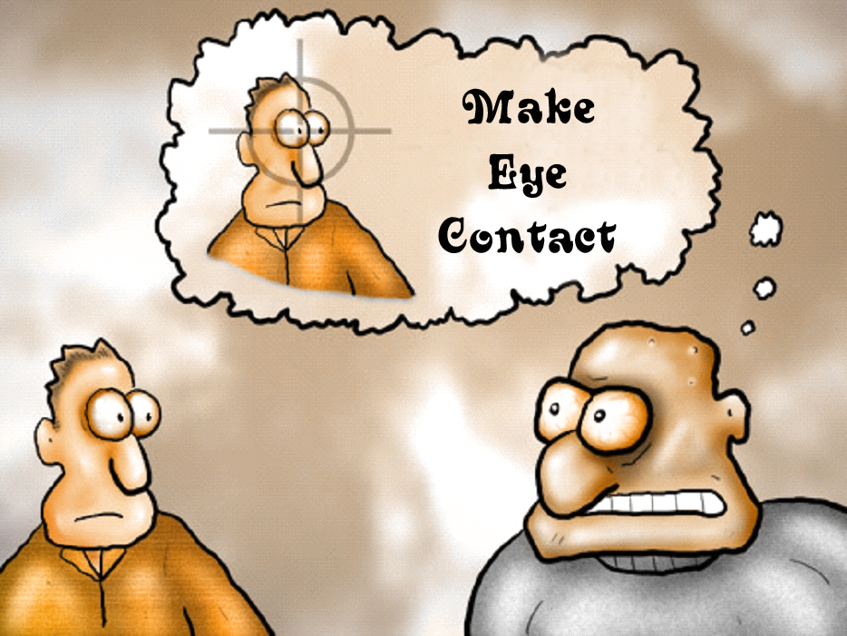
Make eye contact when you talk to a teacher.
. . . and everyone else too!

Slide 7
Say “Please” and “Thank You,” even if you’re given a worksheet

Slide 8
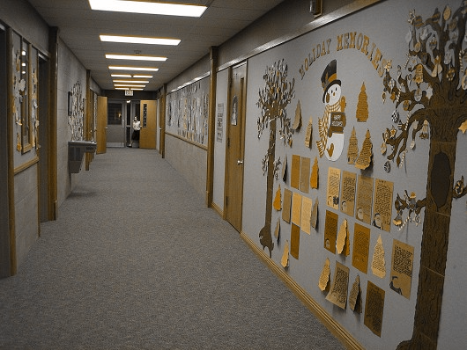
Greet teachers when you see them in the halls.

Slide 9
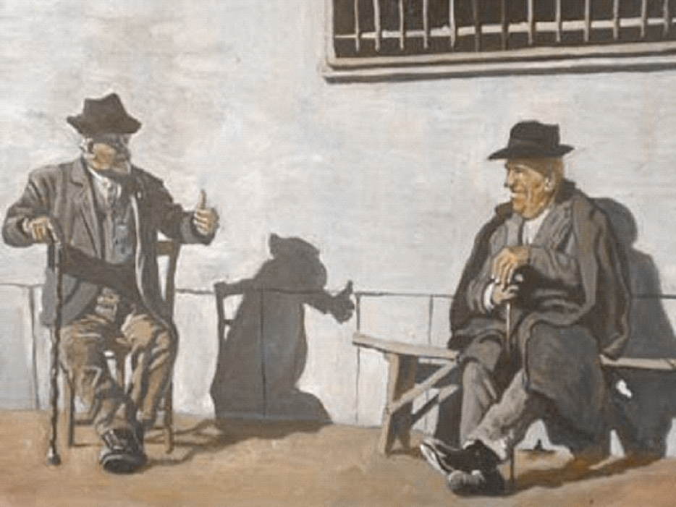
Ask a question back

Slide 10
Actions That Build Trust

Slide 11
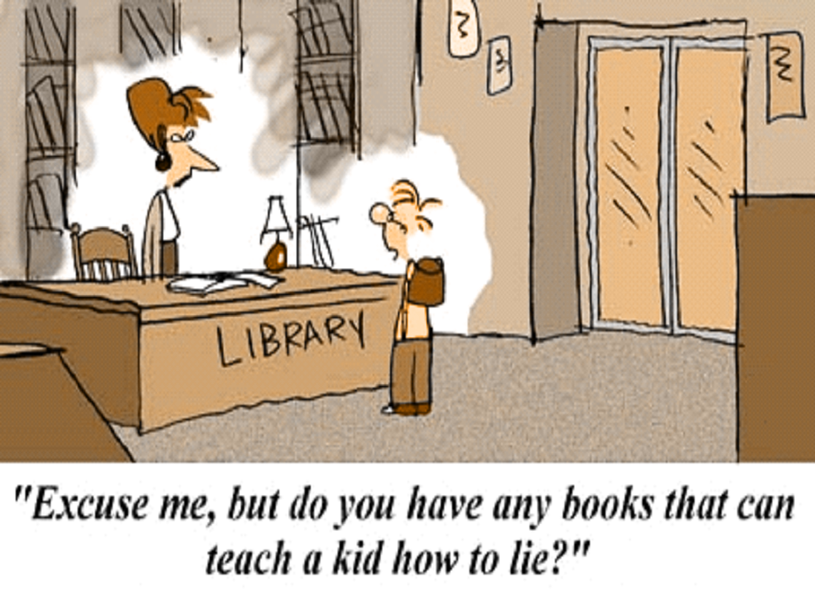
Always tell the truth.

Slide 12
Admit mistakes and poor choices
Don’t make excuses.

Slide 13
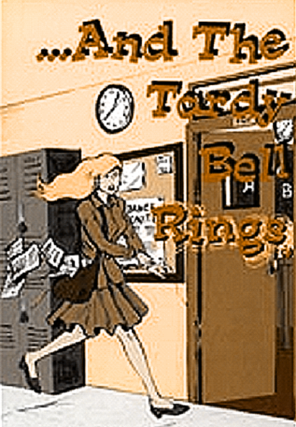
Turn in work on time.

Slide 14
Don’t
be
tardy.

Slide 15
Actions That Show You Care About Your Education

Slide 16
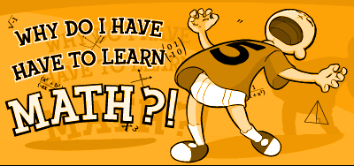
Never question why you need to learn something.

Slide 17

Write neatly.

Slide 18

Answer in complete sentences.

Slide 19
Know how to ask for help.
Use polite language: “Can you please help me with…?”
Be specific: “I’m stuck on step 3.”
Wait patiently if your teacher is busy.
Do not say, “I don’t get it.”
Know how to ask for help.
Use polite language: “Can you please help me with…?”
Be specific: “I’m stuck on step 3.”
Wait patiently if your teacher is busy.
Do not say, “I don’t get it.”

Slide 20
Actions to Avoid

Slide 21
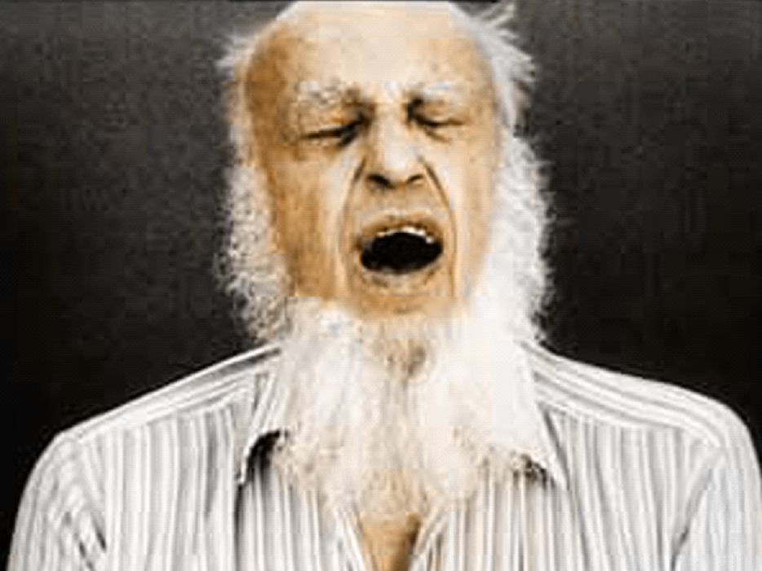
Don’t yell “Bless You!”

Slide 22

Don’t chew gum if the teacher does not allow it

Slide 23

Do not complain or whine. Work harder.

Slide 24
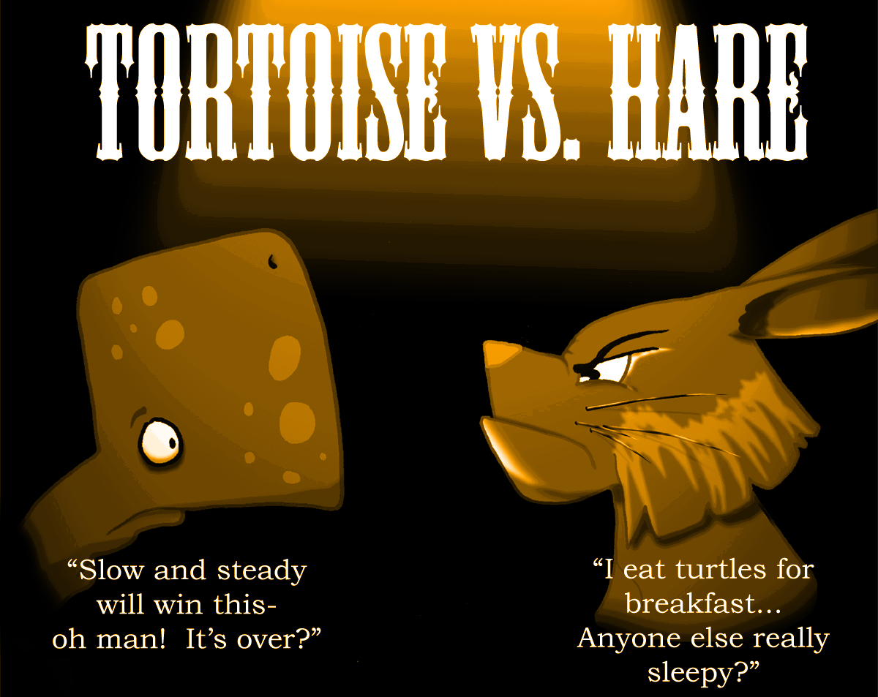
Don’t say “That’s not fair!”
You’re right! Now, deal with it!

Slide 25
Do not ask silly “What if . . .” questions
or any other silly questions.

Slide 26
Wait for the teacher to finish what they are saying before you ask a question

Slide 27
Reflection Question
What is one thing you can do tomorrow to build a better relationship with a teacher?

